Slide 1
Gulliver’s Travels Part 4
By: Hannah, Xavier, Mehek, Bibi, Kevin, Matt, and Paulo
Notes:
Title page

Slide 2
Biography
Jonathan Swift was born on the 30th of November, 1667, at a house in Hoey’s Court in Dublin.
His mother was a widowed and her husband died leaving her a poor estate in the spring of that year
Jonathan Swift father was the seventh or eighth son of Rev. Thomas Swift Vicar of Goodrich, near Ross
Notes:
Biography 1

Slide 3
Jonathan Swift’s Gulliver's Travels is one of the most important works of literature. It is Swift's best known full-length work, and a classic of English literature. It is not known when exactly he wrote it but some sources suggest as early as 1713 when Swift, Gay, Pope, Arbuthnot and others formed the Scriblerus Club, with the aim of satirizing popular literary genres
Notes:
Biography 2

Slide 4
Jonathan Swift Gulliver's Travels is an adventure story involving several voyages of Lemuel Gulliver, a ship's surgeon, who, because of a series of mishaps en route to recognized ports, ends up, instead, on several unknown islands living with people and animals of unusual sizes, behaviors, and philosophies, but who, after each adventure, is somehow able to return to his home in England where he recovers from these unusual experiences and then sets out again on a new voyage.
Notes:
Biography 3

Slide 5
Chapter 1
Gulliver leaves his pregnant wife
Captain of Adventure
Death
Recruiters
Betrayal
Land
Notes:
Chapters 1 and 2

Slide 6
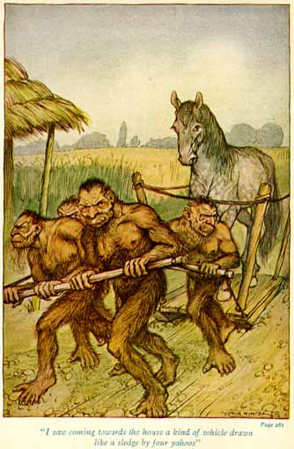
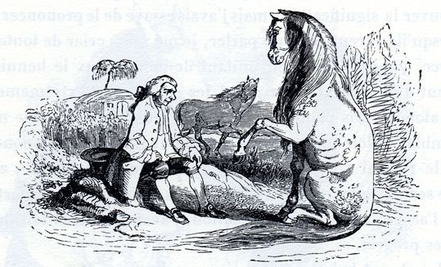
Yahoo and Houyhnhnm
Yahoo- Hairy, eats meat,
Houyhnhnm- horse, eats hay,
Notes:
Chapters 1 and 2

Slide 7
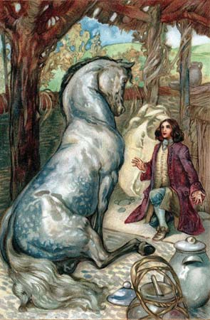
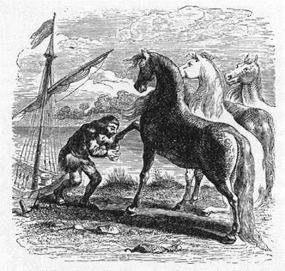
Chapter 2
Building
Wounded horse
Food
Sleep
Notes:
Chapters 1 and 2

Slide 8
Chapter 3
Language
Learning and comprehension
Houyhnhm’s willingness to teach
Author’s willingness to learn
Notes:
Chapters 3 and 4

Slide 9
Chapter 4
Houyhnhnm’s desire and inability to understand the Author’s:
Clothing
Language
Customs
Use of Horses
Methods of Travel
Notes:
Chapters 3 and 4

Slide 10
Theme
According to W.B. Carnochan, a major theme throughout the text is human understanding and the inability to comprehend.
Languages
Customs
“the thing which was not”
Notes:
Chapters 3 and 4

Slide 11
Why Go To War?
Notes:
Chapters 5 and 6

Slide 12
Europe’s Broken Judicial System
“there was a society of men among us, bred up from their youth in the art of proving, by words multiplied for the purpose, that white is black, and black is white, according as they are paid.”
Notes:
Chapters 5 and 6

Slide 13
Separation Of Wealth
“The bulk of our people were forced to live miserably, by labouring every day for small wages, to make few live plentifully”
Like a reverse Robin Hood
Notes:
Chapters 5 and 6

Slide 14
Methods To Becoming Chief Minister
“Knowing how, with prudence, to dispose of a wife, a daughter, or a sister
“Betraying or undermining his predecessor”
Corruption of the court. (Ironic)
Notes:
Chapters 5 and 6

Slide 15
Chapter 7 and 8
“The reader may be disposed to wonder how I could prevail on myself to give so free a representation of my own species...who were already too apt to conceive the vilest opinion of humankind, from that entire congruity betwixt me and their Yahoos.”
Notes:
Chapters 7 and 8

Slide 16
Racism and Classic Literature
“I entered a firm resolution never to return to humankind, but to pass the rest of my life among these admirable Houyhnhnms...”
“another thing he wondered at in the yahoos was their strange disposition to nastiness and dirt” Pg. 2612
Is the racism satirical or real?
Notes:
Chapters 7 and 8

Slide 17
Yahoos vs. The Houyhnhmns
Is the “civilization” of human nature a farce?
Are we really less than other animals?
Is the comparison Swift is making valid?
Notes:
Chapters 7 and 8

Slide 18
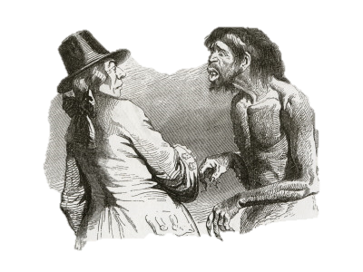
Fate of The Yahoos
A meeting of the Houyhnhnms is held to decide the fate of the yahoos. Gulliver’s master decides to use ideas shared by Gulliver himself in which the yahoo were to be treated as horses were in his country!
Notes:
Chapters 9 and 10

Slide 19
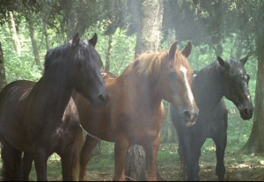
A Simpler Living
Gulliver explains how intelligent and resourceful the Houyhnhnms are. The create simple homes, understand herbal medicines, and live their lives till the die of old age, which they accept and see as a part of life.
Notes:
Chapters 9 and 10

Slide 20
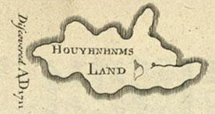
Banishment
Gulliver begins settling more comfortably, and is even made a room to live in. He begins to see people back home as yahoos, and develops an equal disgust. Houyhnhnm’s are unpleased that he is treated as their kind and is asked to leave the island, which he does.
Notes:
Chapters 9 and 10

Slide 21
Gulliver’s Travels Pt. 4: Ch. 11
Gulliver leaves Houyhnhnmland
New Holland barbarians
Rescue by Pedro de Mendez
Don Pedro & Gulliver at Lisbon
Home (not so) Sweet Home
A Piece of Houyhnhnmland
Notes:
Ch 11 and 12… First slide

Slide 22
Gulliver’s Travels Pt. 4: Ch. 12
True Story (If you are Gullibl.. err Gulliver!)
The Crown gets no piece of the pie
If Yahoos were as wise as Houyhnhnms…
Notes:
Ch 11 and 12… Second slide

Slide 23
Deep Sea Analysis
Gulliver has probably gone mental
Houyhnhnmland could be a third world country (but with people instead of horses)
Notes:
Ch 11 and 12… Third slide

Slide 24
Bibliography
Bentman, Raymond. “Satiric Structure and Tone in the Conclusion of Gulliver’s Travels.” Studies in English Literature, 1500-1900 Vol 11, No. 3. Restoration and Eighteenth Century(Summer, 1971) Pg. 535-548. JSTOR. 25 Nov. 2012.
Carnochan, W.B. “Human Behavior Mind and Body in literature” Modern Language Quarterly; Mar 64, Vol. 25, Issue 1 p5, 17p. 25 Nov. 2012.
Cviak, Henry. “Left of Swift.”Swift: Selections From His Work. Literature Sources from Gale. Database. 22 Nov. 2012.
Kelly, Anne Cline. “After Eden: Gulliver's (Linguistic) Travels.” ELH 45.1 (1978):33-54. JSTOR. Web. 25 Nov. 2012.
Nuttal, A.D. “The Yearbook of English Studies, Vol 18, Pope. Swift, and Their Special Number” (1988), pp. 51-67. JSTOR. Web. 25 Nov. 2012.
Washington, Gene. "Swift's 'Gulliver's Travels,' bk. 4, ch. 1." The Explicator 52.2 (1994): 75. Academic OneFile. Web. 25 Nov. 2012.

Slide 25
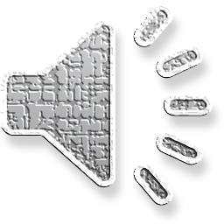
FIN
Notes:
Fin = The End

